Slide 1
Kevin
Ken
?

Slide 2

Notes:
Ken enters room
Excuse
Trains delayed – huge mess

Slide 3
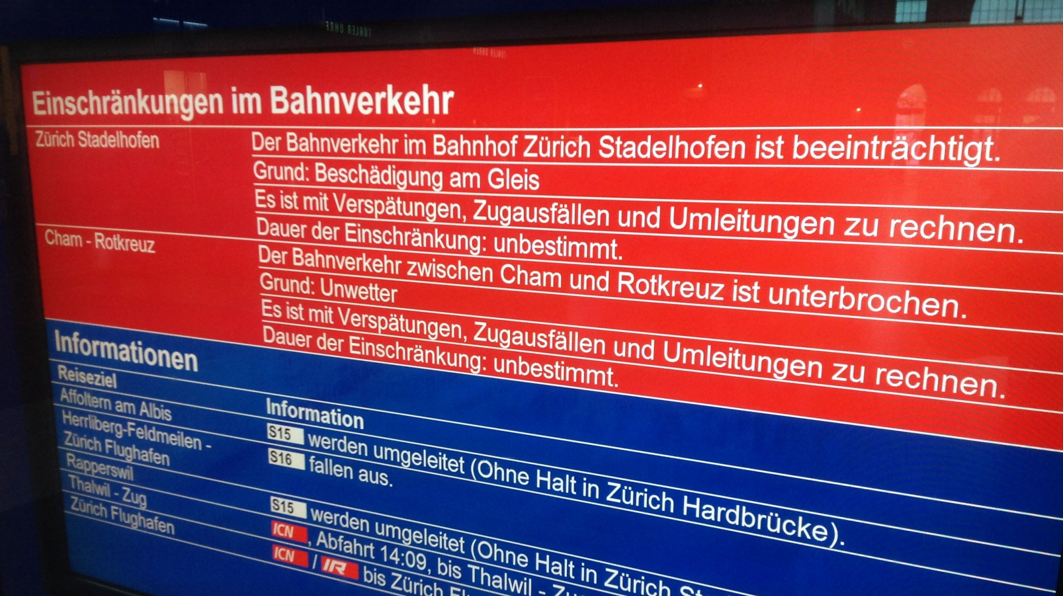
Notes:
Didn’t you check?
Check what?!
Check on the awesome ivisPro app!
What kind of app is that? I have never heard of that..
Let me show you. It is really cool! You will never have to bother anymore

Slide 4



Slide 5
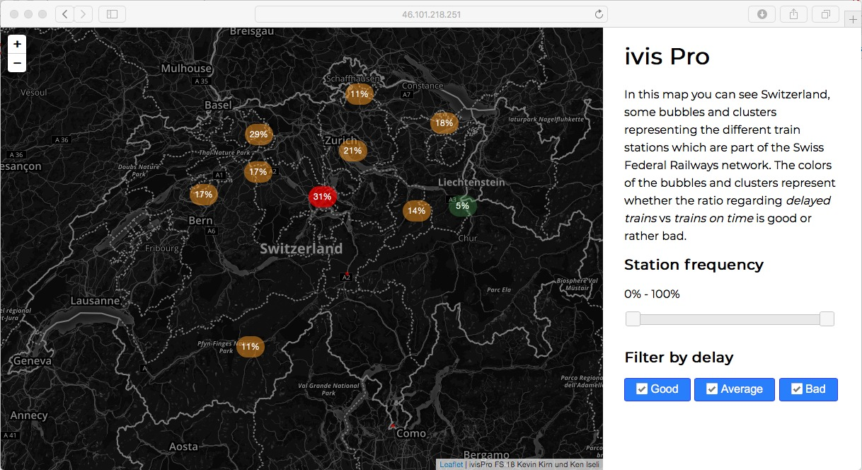
Notes:
What do we see here?

Slide 6

Notes:
Schinznach

Slide 7
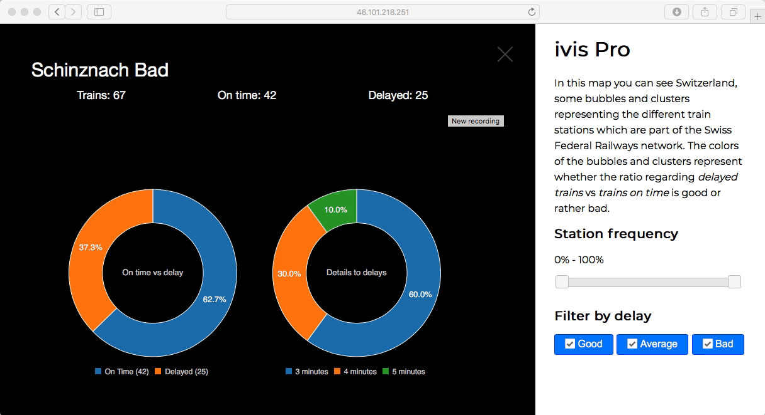
Notes:
Brugg
Cool, but it’s so crowdy here!
What can be done to make it more clear?

Slide 8
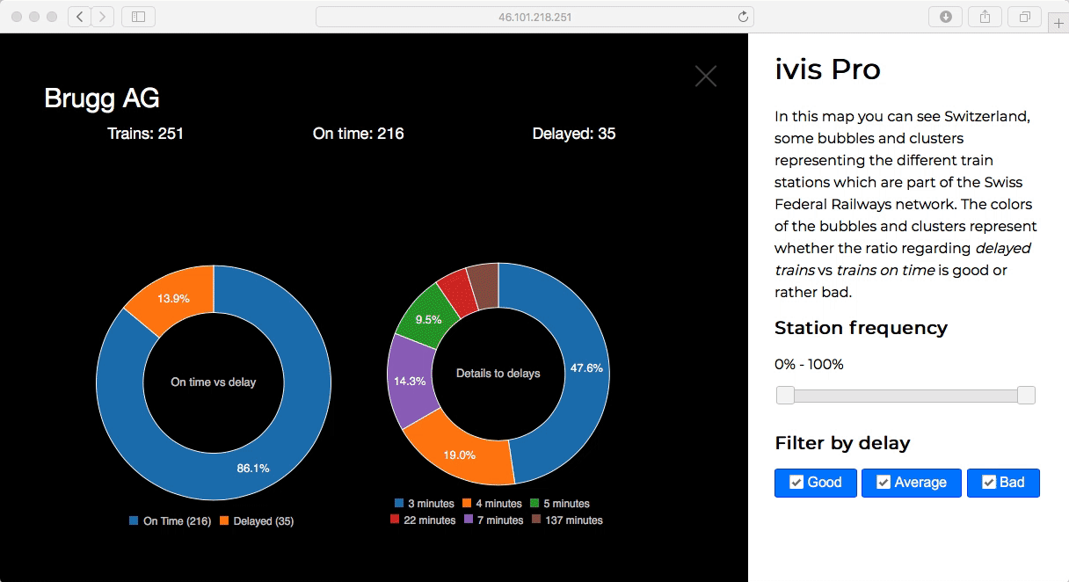
Notes:
Filter

Slide 9
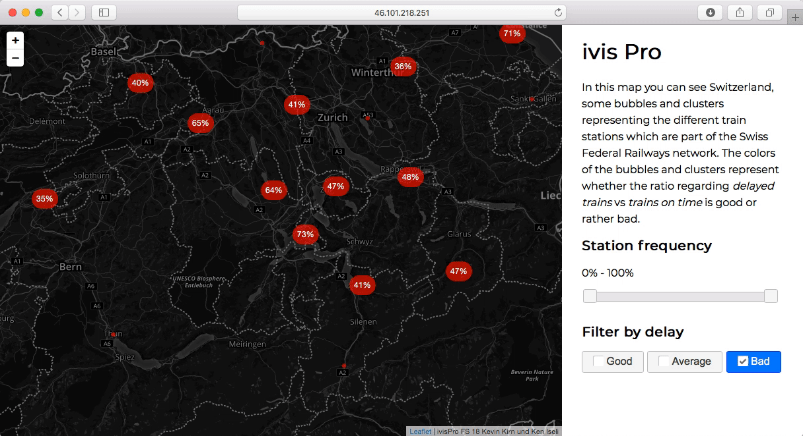
Notes:
Frequency

Slide 10

Notes:
Awesome!
All those charts really help!
I will never have problems dealing with delays and always know where trains are usually delayed!
Hard work!? How can this be built?

Slide 11


Notes:
Google Transit API
Display chart without any live event would be useless
The data quality from google transit api was not great

Slide 12


Notes:
Data.sbb offers a lot of data
data can be requested and analyzed

Slide 13
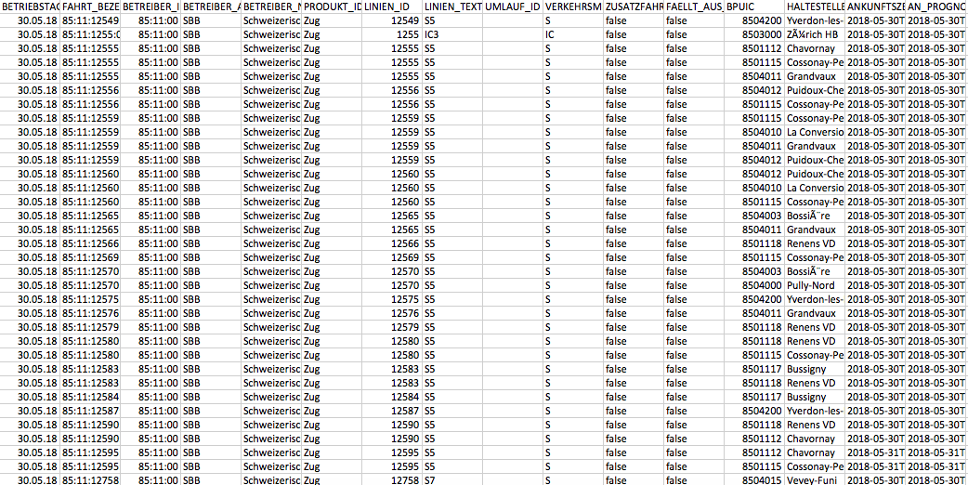

Notes:
Analyzed a buch of excel files to find de data we need.

Slide 14











Notes:
Data analyzation and processing is hard in a technology like JS so we implemented a backend

Slide 15



5’121
462
46’354
Notes:
Which now processes many entities

Slide 16
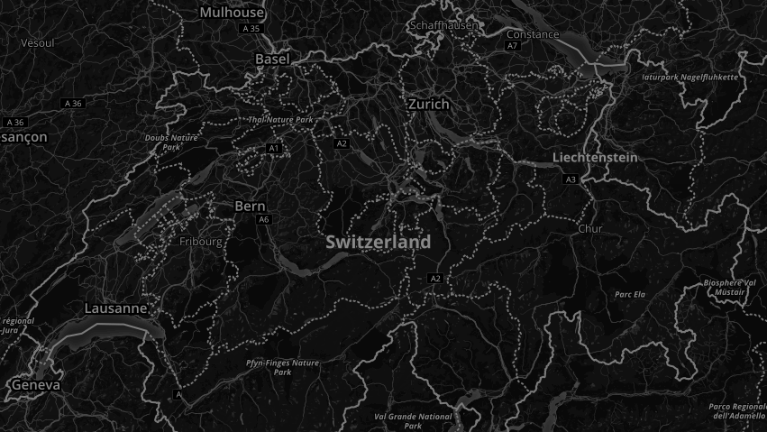


Slide 17
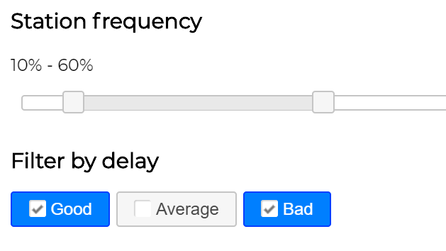

Slide 18
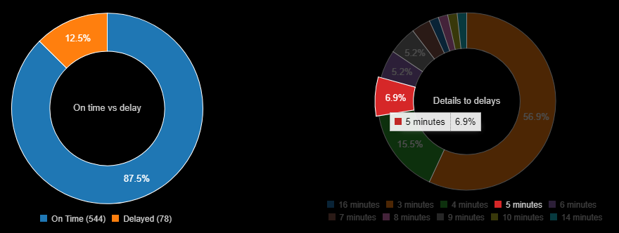

Slide 19

Notes:
In the future one could try to integrate the time dimension as well over days so that smart forecasts are possible

Slide 20

Questions?

